Slide 1
EDC Hackathon II: Building Federated Dataspaces
The Eclipse Dataspace Connector Project

Slide 2
Welcome
Hackathon Scenarios and Tasks
EDC Progress Update
Introduction to Web DIDs
Introduction to the EDC Federated Catalog

Slide 3
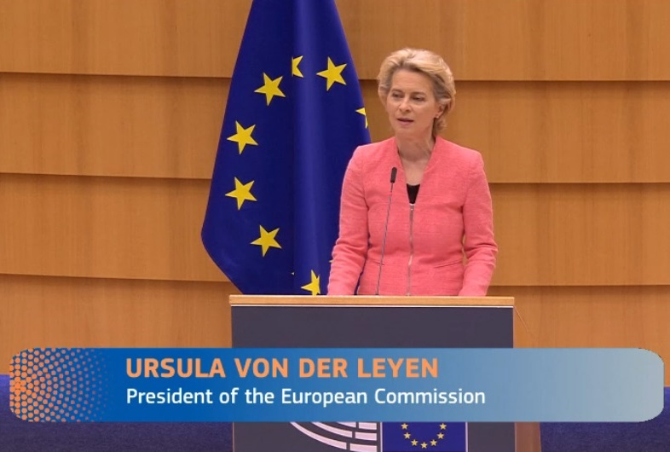
Motivation
»A real data economy, on the other hand, would be a powerful engine for innovation and new jobs. And this is why we need to secure this data for Europe and make it widely accessible. We need common data spaces - for example, in the energy or healthcare sectors. This will support innovation ecosystems in which universities, companies and researchers can access and collaborate on data. And it is why we will build a European cloud as part of NextGenerationEU - based on GaiaX.«

Slide 4
Data Exchange and Sharing Evolution
C
C
B
C
C
C
C
C
C
H
C
C
B
I
C
C
I
Bilateral data exchange
Closed group data exchange
Open and dynamic data exchange

Slide 5
Hackathon Scenarios and Tasks

Slide 6


Hackathon Scenarios
Catena-X
Derived from real-world projects using the EDC
Participants in a dataspace want to advertise, discover, and share data
Some data is private to a subset of the dataspace
Efficiently query data across the dataspace, at scale
Make a Data Service available to others based on the dataspace trust model
Centralized and decentralized identity
Usage and access policies

Slide 7
Key Dataspace Principles
Participants maintain control over their identities
Support for centralized and federated identity models
Participants maintain control over which other participants they trust
Policy-based access control
Participants maintain control over their data
Some data may be private to a subset of the dataspace
Usage policies are transparent and transmitted with data
Automated enforcement or a reasonable expectation of data usage policy enforcement

Slide 8
Technical Challenges
Embrace heterogeneity
Cross cloud, on-premise, edge
Data diversity: streaming, large data, event-based systems
Enable interoperability
Policy semantics
Data exchange technologies
Support scale
Thousands of participants
Accommodate change and evolution

Slide 9
Hackathon Tasks
The EDC is an extensible platform for building a complete dataspace infrastructure
Deploy a Web DID identity system: Federated identities without a blockchain
A flexible solution to identity management that bridges centralized models (OAuth2) and future-looking blockchain approaches based on DNS
Deploy Federated Data Catalogs: Policy-based data search at scale
A scalable solution for advertising and searching for data in a trusted, secure way across thousands of participants
Enable Data Services: A new data sharing scenario
Grant access to a data service based on dataspace identity and trust

Slide 10
EDC Progress Update

Slide 11
EDC Progress Report
The EDC community continues to grow
New project contributions
56 Pull requests merged since the last hackathon
Done by 8 different organizations
New organizations will be officially joining in the near future
The EDC is continuing to evolve into a complete dataspace platform
Federated catalog and query support
Service registration and discovery
Centralized and federated identity services

Slide 12
EDC Roadmap: Milestone 1
Target of December
IDS support
Multipart messaging
Contract offers (assets) with policy-based filtering
Usage policy support
Initial contract negotiation support
DAPs integration
Cloud-to-cloud data transfer

Slide 13
Further information and contact
General project information:
https://projects.eclipse.org/projects/technology.dsconnector​
Github-Repository:
https://github.com/eclipse-dataspaceconnector/DataSpaceConnector
Mailing list:
dsconnector-dev@eclipse.org
YT-Channel
https://www.youtube.com/channel/UCYmjEHtMSzycheBB4AeITHg

